Slide 1

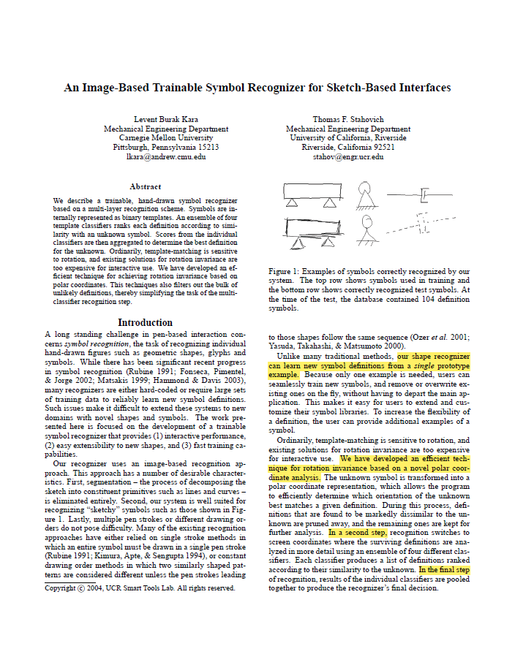

An Image-Based Trainable Symbol Recognizer for Sketch-Based Interfaces
Paper by
Kara L., Stahovich T.
Presentation by
Beau De Clercq

Slide 2


Roadmap
Problem at hand
Solution

Slide 3
Problem at hand
Trainable symbol recognizer

Slide 4
Solution
Three steps
Transform to polar coordinates
Switch to screen coordinates and classify
Combine results
Notes:
The unknown symbol is transformed into a polar coordinate representation, which allows the program to efficiently determine which orientation of the unknown best matches a given definition. During this process, definitions that are found to be markedly dissimilar to the unknown are pruned away, and the remaining ones are kept for further analysis.
In a second step, recognition switches to screen coordinates where the surviving definitions are analyzed in more detail using an ensemble of four different classifiers. Each classifier produces a list of definitions ranked according to their similarity to the unknown.
In the final step of recognition, results of the individual classifiers are pooled together to produce the recognizer’s final decision.

Slide 5
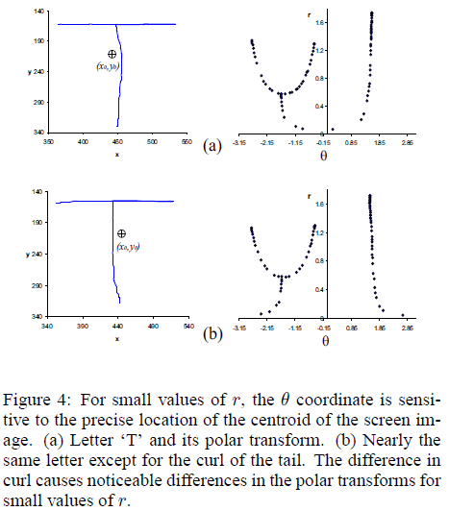
Solution – transform
Matching sensitive to orientation
Rotate
Notes:
For rotation invariant recognition, it is necessary to first rotate the patterns into the same orientation. Often this is accomplished by incrementally rotating one pattern relative to the other until the best alignment is achieved.
Because this is expensive for real-time applications, a custom procedure is proposed based on polar coordinates. The main idea is that rotations in Cartesian coordinates become translations in polar coordinates.
One difficulty with the polar transform is that data near the centroid of the original image is sensitive to the precise location of the centroid.
The degree of match between two polar images provides a reasonable estimate of the match of the original screen images. The match in polar coordinates discounts data near the centroid of the screen image, which can result in false positive matches but it rarely results in false negative matches. Thus, the polar analysis can be used as a pre-recognition step to eliminate unlikely definitions.
In practice, the correct definition for an unknown is among the definitions ranked in the top 10% by the polar coordinate matching.

Slide 6
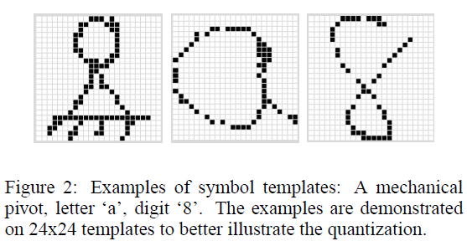
Solution – recognition (1)
Match symbol template against DB
Haussdorf and modified Haussdorf
Tanimoto and Yule coefficient
Notes:
In the recognition phase, the template of the symbol is matched against the templates stored in the DB. Matching is done using 4 different methods.

Slide 7
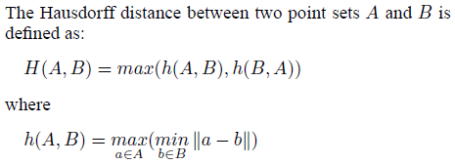

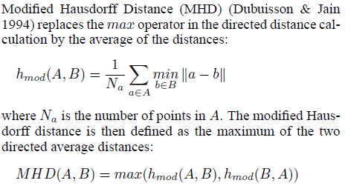
Hausdorff distance
measures dissimilarity between point sets
Notes:
In its original form, the Hausdorff distance is too sensitive to outliers. The Partial Hausdorff distance proposed by Rucklidge (1996) eliminates this problem by ranking the points in A according to their distances to points in B in descending order,
and assigning the distance of the kth ranked point as h(A;B).
The difference between h_mod and h_k is that the former corresponds to the mean directed distance while the latter corresponds to the median. It can be argued that the average directed distance is more reliable than the partial directed distance mainly because as the noise level increases, the former degrades gracefully whereas the latter exhibits a pass/no-pass behavior.

Slide 8


Tanimoto and Yule
Notes:
The Tanimoto Similarity coefficient is defined as T_sc where T and T^c are the Tanimoto coefficient and Tanimoto coefficient complement. T^c is defined in a similar way as T, but in stead it looks at the amount of white pixels in stead of the amount of black pixels. Alpha is a weigth to determine the relative contributions. These measures give us an indication on overlapping pixels.
The Yule coefficient gives a measure of association between sets A and B, it produces values between 1.0 (maximum similarity) and -1.0 (minimum similarity). Like the Tanimoto coefficient, the Yule coefficient is sensitive to slight misalignments
between patterns. This occurs when rastized images of apparently similar shapes are almost always dissimilar either due to differences in shape, or more subtly, due to differences in drawing dynamics. The latter commonly occurs as a result of irregular drawing speed, often manifesting itself as unevenly sampled digital ink. Hence, for two shapes drawn at different speeds, the resulting rasterized images will likely exhibit differences.
In order to absorb such variations during matching, we use a thresholded matching criterion.

Slide 9
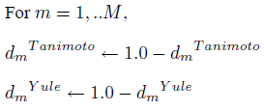




Solution – recognition (2)
Combine classifiers
Issues
Transform coefficients
Normalize results
Combination rule
Notes:
The outputs of the classifiers are not compatible in their original forms because: (1) The first two classifiers are measures of dissimilarity while the last two are measures of similarity, and (2) the classifiers have dissimilar ranges.
For more information as to how the transformations and normalization occurs I reffer to the paper.
After we have transformed and normalized the values, we can combine them using the combination rule. An unknow symbol then gets the value m*.

